Slide 1
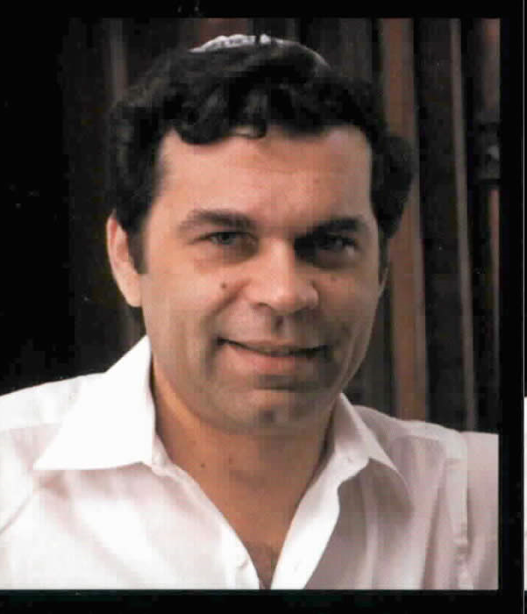

Critical Chain
From “Theory of Constraints” Developed by Elihu Goldratt in 1984
Goldratt – Many of his key ideas were first explained via “business novels” like The Goal: A Process of Ongoing Improvement.

Slide 2
What is the “Theory of Constraints”?
The theory of constraints (TOC) is a management paradigm that views any manageable system as being limited in achieving more of its goals by a very small number of constraints.
Based on “how people really behave.”
Includes lots of ideas to turn that into project productivity!
“Critical chain” is one of these ideas…

Slide 3
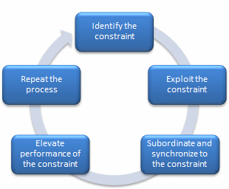
The article you read
Describes the classic Theory of Constraints
Shows how it has been applied to manufacturing, especially.
Goal is process
improvement.
Let’s now apply
to software
projects…

Slide 4
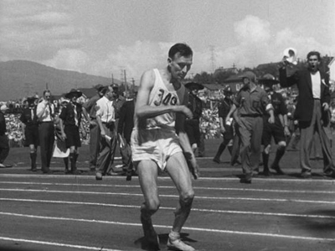
The worst thing you can do for your process is try to make every step complete on time.
The result of sub-optimized speed, in action – Marathoner Jim Peters collapses in his final race, in 1954, 150 meters from the finish line. He always started the races too fast, intent on dominating the field. But, he was the first person to run a marathon in under 2:20:00.
Notes:
Image from http://www.runningjunkies.com/jim-peters/

Slide 5
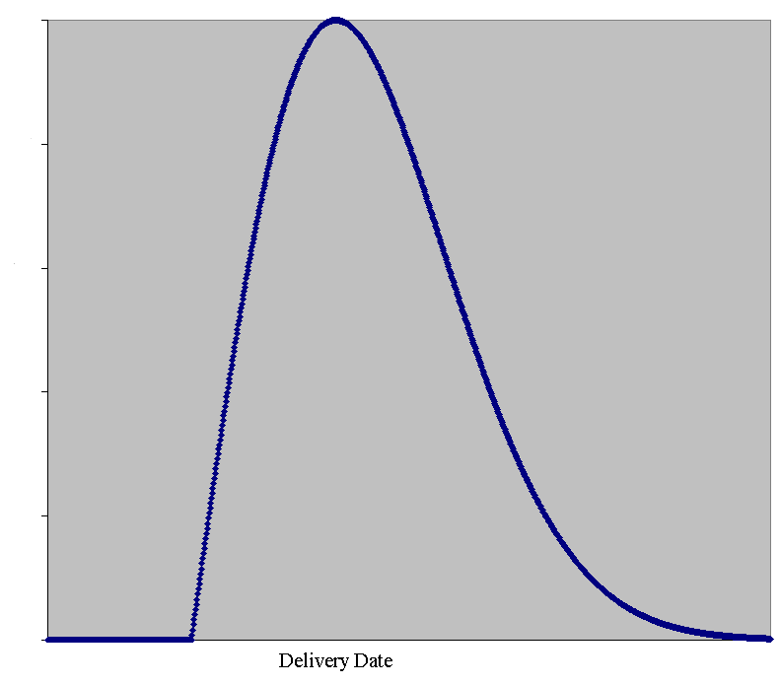

How long does it take you to get to your relatives, for Memorial Day?
Notes:
Norman Rockwell image from http://thehighpointeinn.com/blog/2012/05/07/norman-rockwell-visits-cape-cod.
Rayleigh curve image from http://www.ganssle.com/articles/liesandschedules.htm

Slide 6
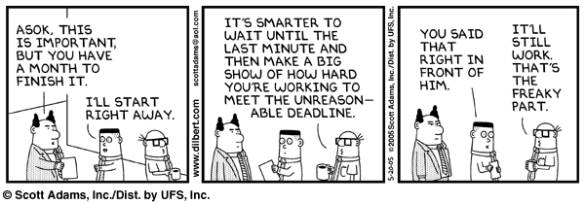
How much safety do our estimates contain?
A lot of management and customer happiness is built into our making / not making deadlines!
We know we’re likely to be optimistic. So,
Why not pad the estimates, allowing for likely delays?
Notes:
Key insight – it depends on the probability
Image from http://www.danehomenick.com/productivity/parkinsons-law/

Slide 7
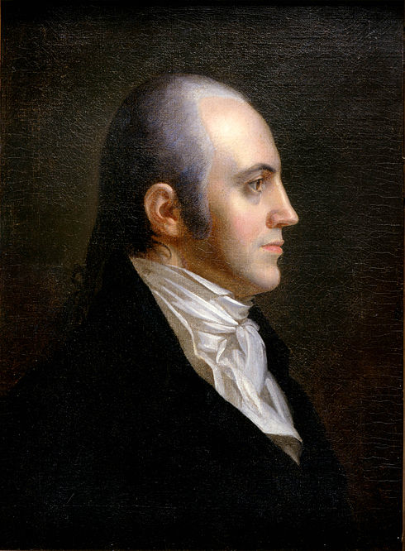
What causes Parkinson’s Law?
Parkinson’s Law: Work expands to fill the time available
Benefits of finishing early
Student syndrome
Multitasking
“And if you finish memorizing the names of all the presidents, go ahead and memorize the names of all the vice-presidents.”
Notes:
Aaron Burr portrait from http://en.wikipedia.org/wiki/Aaron_Burr

Slide 8
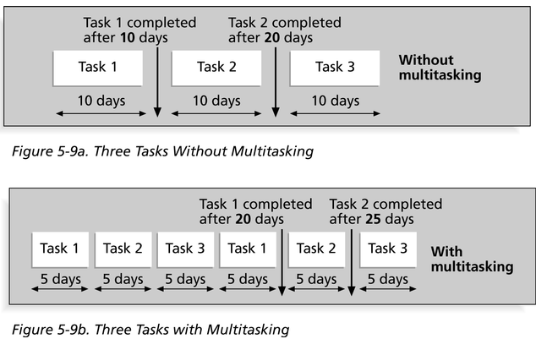
Multitasking’s effects

Slide 9
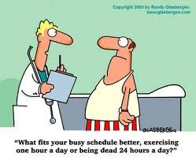
What can we do?
Being realistic about human behavior is a part of Goldratt’s theory.
Notes:
Cartoon from http://www.lisalesliefitnessblog.com/my-solution-to-the-current-economic-crisis-an-alternative-work-schedule-do-you-agree

Slide 10
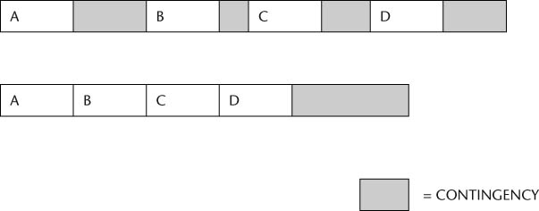
Goldratt’s solution –
Reduce the estimate of everything by half (approximately) and move the buffer to the end
Half the total of all the shaded buffers, above.
Why is this better?

Slide 11
“Project buffer”
Encourages folks to finish early
Makes problems more visible
Focuses attention on the real goal of the process

Slide 12
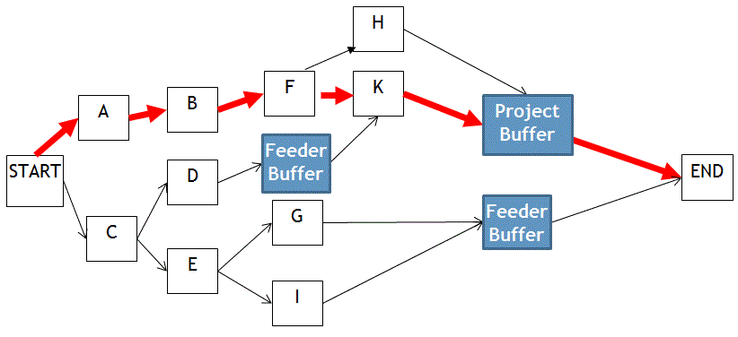
What about situations where there are complex dependencies?
Notes:
The critical path, A-B-F-K is in red.
It works just like A-B-C-D on previous slide.
Accumulate project buffer at the end of A-B-F-K.
The other paths need their own “Feeding buffers” for feeding into the critical path at the right time.
Image from http://www.firebrandtraining.co.uk/learn/pmp/course-material/project-time-management/develop-schedule.

Slide 13
Student syndrome & large projects
Student syndrome: tendency of people to waste “safety buffer” without starting tasks – reintroducing risk no matter how generous the buffer
A real problem on projects with interdependencies
  Consider things like, “The same person has to do C and G.”
You’ve seen how critical chain handles this problem
  Managing the global buffer(s) and resources.
Can you solve this problem in your projects?

Slide 14
BTW: Please don’t confuse critical path and critical chain
Critical path is the longest path through a PERT chart
Critical chain is this thing we’re discussing, with reduced estimation time and buffers
  Within the overall methodology, there is also a smaller thing called “critical chain” involving a critical path that takes into account certain resource contentions. Don’t worry about it.

